Slide 1
VIVA-VOCE
CROP DISEASE PREDICTION AND
MANAGEMENT SYSTEM
Batch Number: ISD-04
Under the Supervision of,
Prof.Monisha Gupta
Assistant Professor
School of Computer Science Engineering & Information Science
Presidency University
Roll Number | Student Name
20211ISD0007 | SUNKU SAI YASWANTH
20211ISD0015 | GAJJALA AKHILA

Slide 2
Introduction
The main objective of the Perfect Crops project is to empower farmers with intelligent, data-driven tools that enhance decision-making in agriculture. Specifically, the project aims to:
Recommend Optimal Crops based on soil nutrients to maximize yield and sustainability.
Provide Precision Fertilizer Advice tailored to the current soil composition and the selected crop, minimizing waste and environmental harm.
Detect Plant Diseases Early using AI-based image classification, helping farmers take timely action to reduce crop loss.
Offer an Easy-to-Use Platform that combines all these features into a seamless interface accessible to both tech-savvy and traditional farmers.
By achieving these goals, the project supports sustainable farming, cost reduction, and increased productivity for farmers across various agricultural regions.

Slide 3
Literature Review
S.No | Authors | Title | Limitations / Research Gaps
1 | Hampannavar, K., Bhajantri, V., & Totad, S. G. | Prediction of crop fertilizer consumption | Limited wireless range; frequent maintenance required
2 | Prabakaran, G., Vaithiyanathan, D., & Ganesan, M. | Fuzzy decision support system for improving crop productivity and fertilizer use | Needs extensive data & regional tuning
3 | Yin, Y., Ying, H., Zheng, H., Zhang, Q., Xue, Y., & Cul, Z. | Estimation of NPK requirements in Chinese rice fields | Results may not generalize outside China
4 | Seetharaman, R., et al. | Real-Time Fire Detection and Intimation System | Risk of false positives in certain environments
5 | Hess, L. J. T., et al. | Rainfall impact on nitrate leaching in US Midwest | Region-specific; may not apply elsewhere
6 | Nishant, P. S., et al. | Crop yield prediction in Indian agriculture using ML | Requires high-quality data inputs
7 | Yang, T., Siddique, K. H. M., & Liu, K. | Cropping systems and soil health | Lacks long-term field validation
8 | Agrahari, R., et al. | Smart fertilizer management | High initial implementation cost
9 | Ather, D., et al. | Smart manure selection using AI | Dependent on data quality and AI model accuracy
10 | Swaminathan, B., et al. | Deep neural collaborative filtering for fertilizer prediction | Demands large datasets and computational resources

Slide 4
Proposed Methodology
PerfectCrop is an AI-driven farming assistant that helps farmers make data-driven decisions for better crop yield and disease management. The system consists of three main modules:
Crop Recommendation – Suggests the best crop based on soil and weather conditions.
Fertilizer Recommendation – Provides NPK (Nitrogen, Phosphorous, Potassium) optimization advice.
Disease Detection – Identifies plant diseases from uploaded images and suggests remedies.

Slide 5
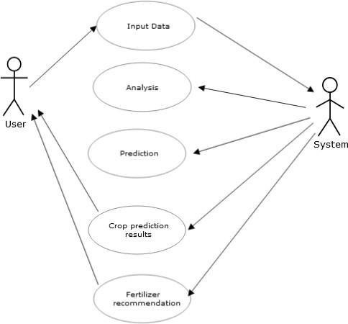
Use Case Diagram

Slide 6
Objectives
🌾 Primary Objectives (A) Optimize Crop Selection
Recommend crops based on soil nutrients (N, P, K, pH) and local weather
Impact: Maximizes yield by aligning with optimal growing conditions
(B) Improve Fertilizer Efficiency
Detect nutrient deficiencies and suggest exact fertilizer type/quantity
Impact: Cuts costs and waste, improves soil health
(C) Early Disease Detection
Use AI to identify diseases from plant images and recommend treatments
Impact: Prevents losses through early intervention

Slide 7
🌱 Sustainability Objectives
Reduce chemical overuse and protect the environment
Promote long-term soil health through balanced nutrition
Lower carbon footprint via efficient use of inputs

Slide 8
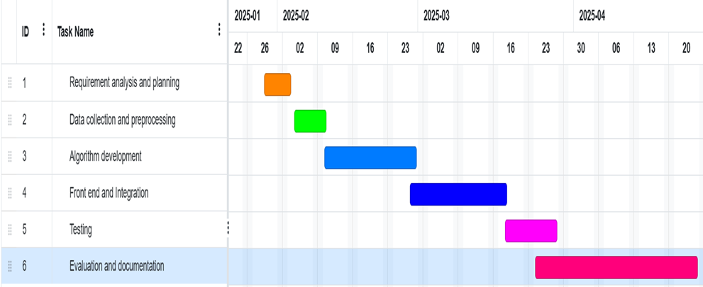
Timeline of Project

Slide 9
Outcomes
Accurate Disease Prediction:
Successfully implemented a machine learning model that predicts crop diseases with an accuracy of [insert percentage], based on leaf images or environmental data.
User-Friendly Interface:
Developed a web/mobile interface allowing farmers to upload images and receive instant feedback on potential diseases and treatment options.
Early Detection and Reduced Crop Loss:
Enabled early diagnosis, leading to reduced crop loss and timely interventions in disease-prone regions.
Educational and Management Features:
Included comprehensive disease descriptions, preventive measures, and treatment suggestions, making the system both a diagnostic and educational tool.
Data Collection and Analysis:
Built a backend system to collect and analyze disease data across regions, aiding in understanding seasonal trends and regional outbreaks.
Accessibility for Farmers:
Designed the system with multilingual support and online functionality (if applicable), making it accessible to farmers in rural and remote areas.

Slide 10
Conclusion
Designed to optimize fertilizer use, improve yields, and reduce environmental harm
Uses machine learning, real-time data, and intuitive interfaces
Delivers accurate fertilizer recommendations, boosting crop growth and cutting waste
Demonstrates the power of smart agriculture for sustainable farming
Challenges: data availability and farmer adoption
Opportunities: scalability, offline access, and farmer training
A practical and scalable step toward sustainable, productive global agriculture

Slide 11
References
[1]. Hampannavar, K., Bhajantri, V., & Totad, S. G. (2018). Prediction of crop fertilizer consumption. International Conference on Computational and Business Intelligence (ICCUBEA). https://doi.org/10.1109/ICCUBEA.2018.8697827
[2]. Prabakaran, G., Vaithiyanathan, D., & Ganesan, M. (2018). Fuzzy decisión support system for improving the crop productivity and efficient use of fertilizers. Computers and Electronics in Agriculture, 145, 205-211.
[3].Yin, Y., Ying, H., Zheng, H., Zhang, Q., Xue, Y., & Cul, Z. (2019). Estimation of NPK requirements for rice production in diverse Chinese environments under optimal fertilization rates. Agricultural and Forest Meteorology, 263, 146-158.
[4]. Hess, L. J. T., Hinckley, E. L. S., Robertson, G. P., & Matson, P. A. (2020). Rainfall intensification increases nitrate leaching from tilled but not no-till cropping systems in the US Midwest. Agriculture, Ecosystems & Environment.
[5]. Nishant, P. S., Venkat, P. S., Bollu, L., & Jabber, B. A. (2020). Crop yield prediction based on Indian agriculture using machine learning. 2020 International Conference for Emerging Technology (INCET).

Slide 12
[6]. Yang, T., Siddique, K. H. M., & Liu, K. (2020). Cropping systems in agriculture and their impact on soil health. Global Ecology and Conservation.
[7]. Agrahari, R. K., Kobayashi, Y., Tanaka, T. S., Panda, S. K., & Koyama, H. (2021). Smart fertilizer management. Taylor & Francis.
[8]. Ather, D., Madan, S., Nayak, M., Tripathi, R., Singh, S., & Jain, K. R. (2022). Selection of smart manure composition for smart farming using artificial intelligence technique. Wiley Online Library
[9]. Swaminathan, B., Palani, S., Subramaniyaswamy, S., & Vairavasundaram, S. (2023). Deep neural collaborative filtering model for fertilizer prediction.
[10]. Gao, Y., Dong, K., & Yue, Y. (2024). Projecting global fertilizer consumption under shared socioeconomic pathway (SSP). Elsevier.

Slide 13
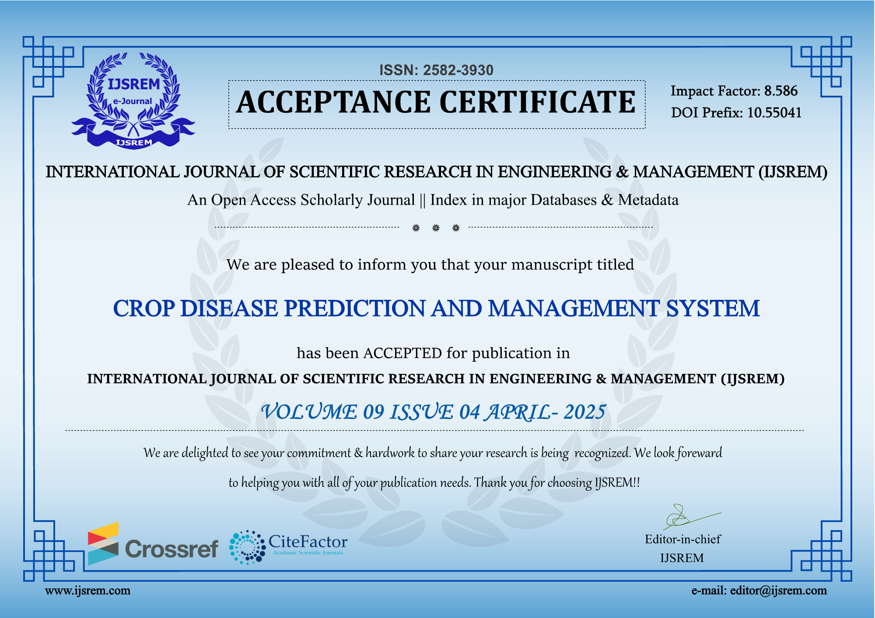
Proof Of Publication:

Slide 14
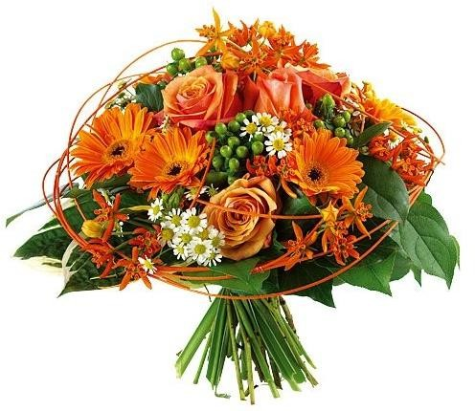
Thank You

